Slide 1


CE141: COMPUTER CONCEPTS & PROGRAMMING
July – November 2018
Chapter – 2
Algorithms and Flowcharts
Devang Patel Institute of Advance Technology and Research

Slide 2


Objectives
To understand the concept of an algorithm
To define and use three constructs for developing algorithms: sequence, decision, and repetition
To Understand and use flowchart to represent algorithms
Chapter – 2 : Algorithms and Flowcharts

Slide 3
Problem Solving Techniques
Problem Definition
Analysis of Problem
Find out Input and Output if require
Choose Appropriate tools to solve problem (Algorithm or Flowchart)
Choose Appropriate control structure for developing program (Code Design)
Run and debug the program (Error Finding)
Verify the Output as per Definition
Chapter – 2 : Algorithms and Flowcharts

Slide 4
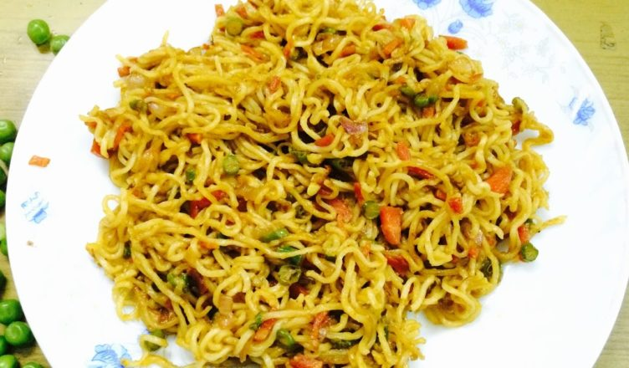
How to Make Maggi?
Chapter – 2 : Algorithms and Flowcharts

Slide 5
How to Make Maggi?
Step 1: Take pan with water
Step 2: Put pan on the burner
Step 3: Switch on the gas/burner
Step 4: Put magi and masala
Step 5: Give two minutes to boil
Step 6: Take off the pan
Step 7: Take out the magi with the help of fork/spoon
Step 8: Put the maggi on the plate and serve it
Chapter – 2 : Algorithms and Flowcharts

Slide 6
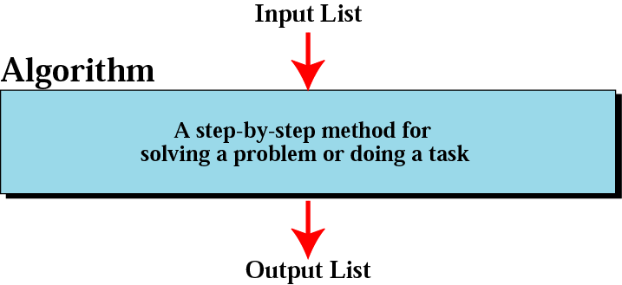
Algorithm
Finite sequence of well defined steps or operations for solving a problem in systematic manner
Rules for solving any problem in proper manner
Also called as Step By Step Solution
Chapter – 2 : Algorithms and Flowcharts

Slide 7
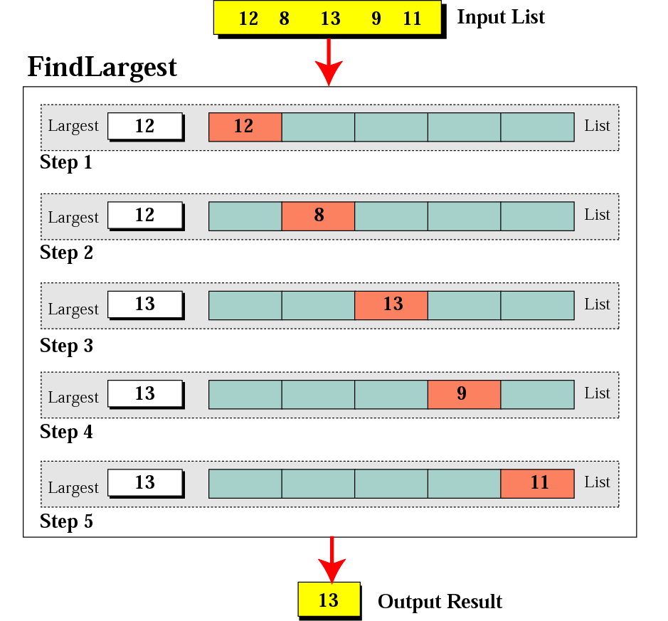
Finding the Largest integer
Chapter – 2 : Algorithms and Flowcharts

Slide 8
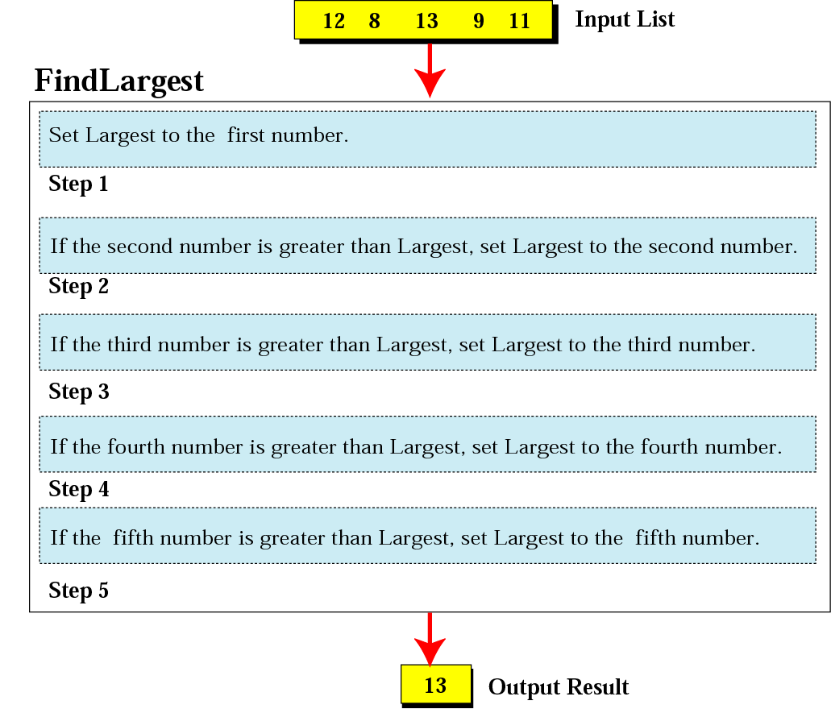
Actions in FindLargest algorithm
Chapter – 2 : Algorithms and Flowcharts

Slide 9
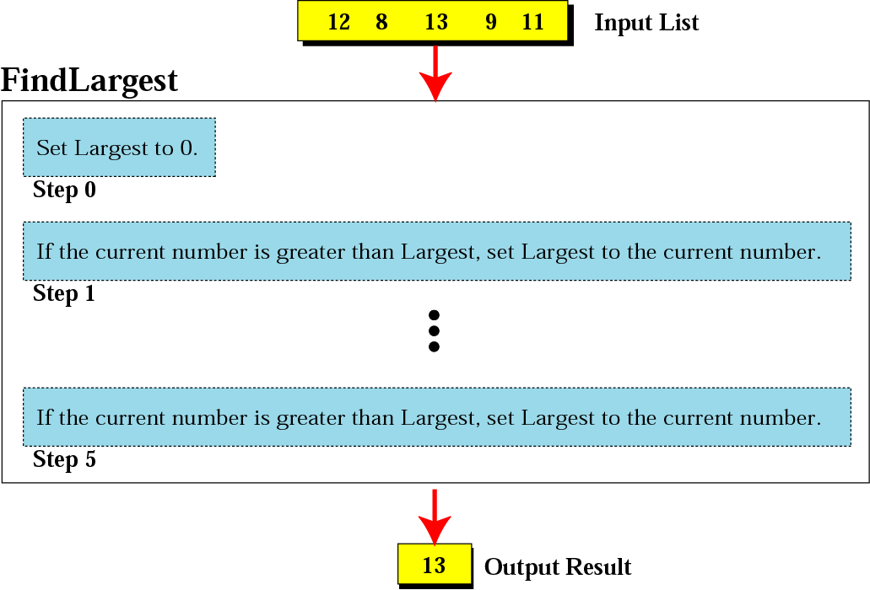
Find Largest refined
Chapter – 2 : Algorithms and Flowcharts

Slide 10
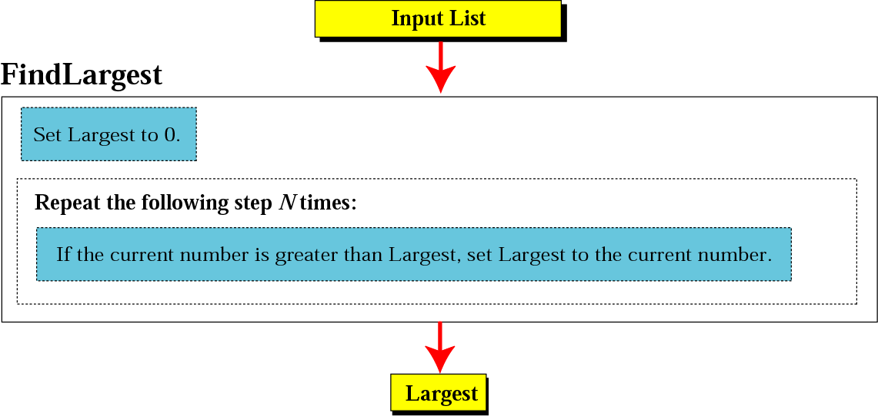
Generalization of FindLargest
Chapter – 2 : Algorithms and Flowcharts

Slide 11
Types of Algorithm
Divide and Conquer
Greedy Method
Branch and Bound
Recursion
Effectiveness
Chapter – 2 : Algorithms and Flowcharts

Slide 12
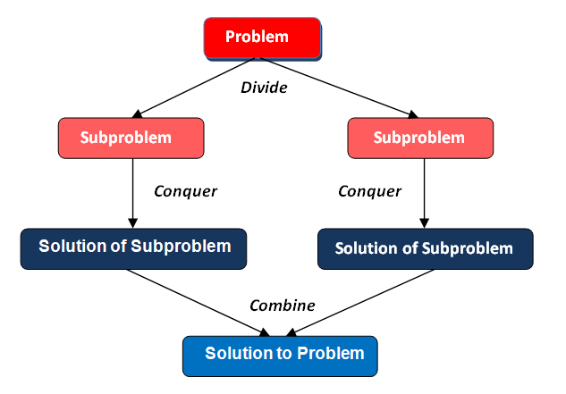
Divide and Conquer
Chapter – 2 : Algorithms and Flowcharts

Slide 13
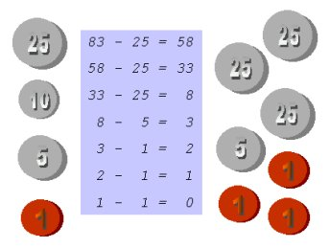
Greedy Method
Chapter – 2 : Algorithms and Flowcharts

Slide 14
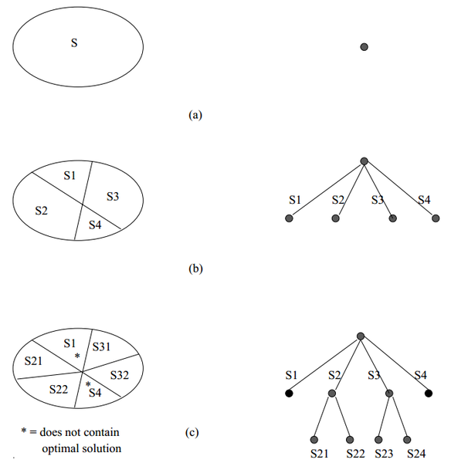
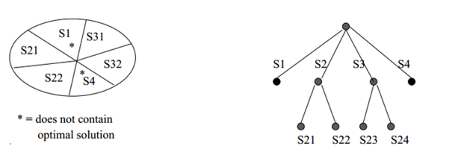
Branch and Bound
To search only parts of the solution space implicitly
Chapter – 2 : Algorithms and Flowcharts

Slide 15
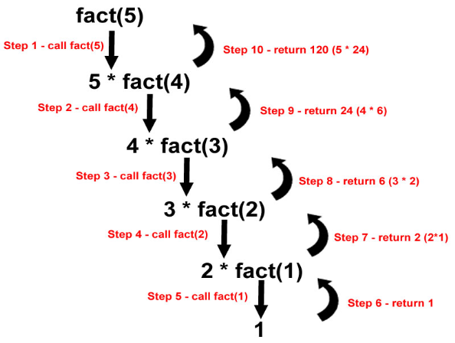
Recursion
Chapter – 2 : Algorithms and Flowcharts

Slide 16
Effectiveness
All operations can be carried out in predefined time and space
Chapter – 2 : Algorithms and Flowcharts

Slide 17
Pseudo Code
Pseudo code is an informal high-level description of the operating principle of a computer program or other algorithm. It uses the structural conventions of a normal programming language, but is intended for human reading rather than machine reading.
Algorithm
If(grade >= 60) printf("passed ");
else
printf("failed ");
Pseudo code
If student's grade is greater than or equal to 60
print passed
else
print failed
Chapter – 2 : Algorithms and Flowcharts

Slide 18
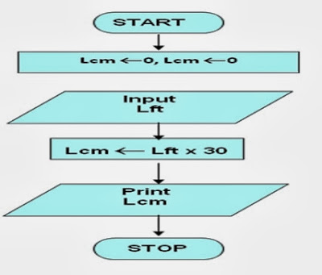
3 Types of Algorithm
Convert the length in feet to centimeter.
Step- Form
Pseudo-code
Flow chart
Input the length in feet.
Calculate the length in cm by multiplying feet with 30.
Print length in cm.
Step 1: Input Lf
Step 2: Lcm = Lf x 30
Step 3: Print Lcm
For your information
1 feet = 30 cm
Chapter – 2 : Algorithms and Flowcharts

Slide 19
Rules to Write Algorithm
Each algorithm will be logically enclosed by two statements START and STOP.
To accept data from user, the INPUT or READ statements are to be used.
To display any user message or the content in a variable, PRINT statement will be used. Note that the message will be enclosed within quotes.
There are several steps in an algorithm. Each step results in an action. The steps are to be acted upon sequentially in the order they are arranged or directed
Computer Science: A Structured Programming Approach Using C

Slide 20
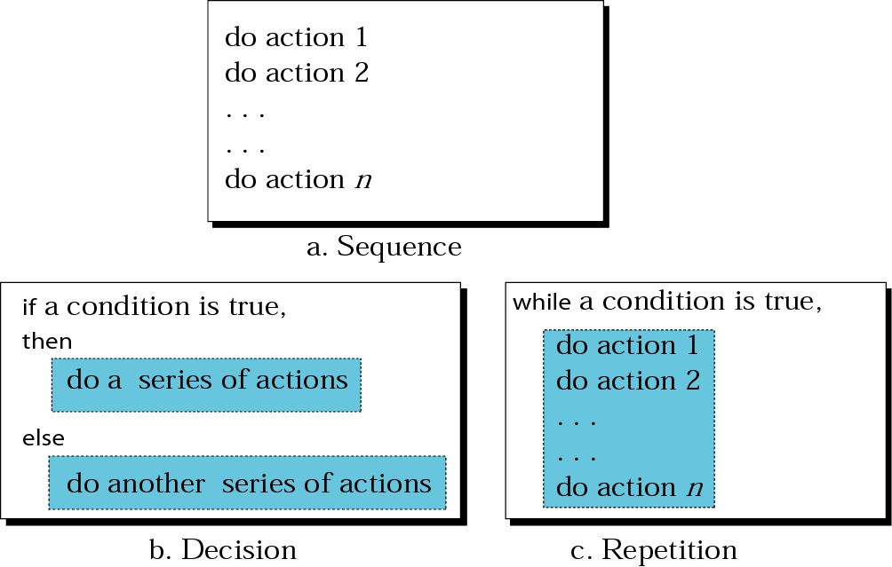
Three Construct of Programming
Chapter – 2 : Algorithms and Flowcharts

Slide 21
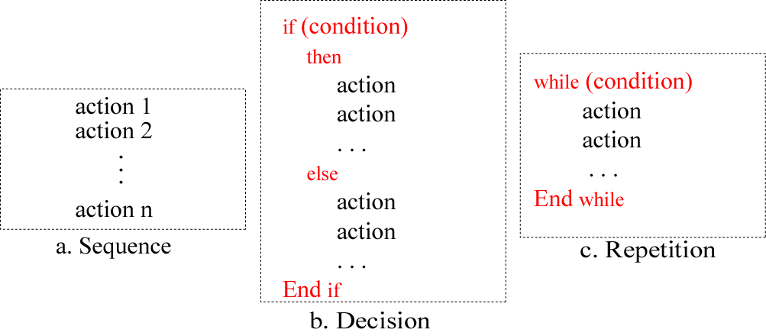
Three Construct of Programming
Chapter – 2 : Algorithms and Flowcharts

Slide 22
Examples-Sequence
Write the algorithm for finding the sum of any two numbers.
Let the two numbers be A and B and let their sum be equal to C. Then, the desired algorithm is given as follows:
1. START
2. PRINT “ENTER TWO NUMBERS”
3. INPUT A, B
4. C←A + B
Add values assigned to A and B and assign this value to C
5. PRINT C
6. STOP
Chapter – 2 : Algorithms and Flowcharts

Slide 23
Example- Decision
Write an algorithm that compares two numbers and prints either the message identifying the greater number or the message stating that both numbers are equal.
1. START
2. PRINT “ENTER TWO NUMBERS”
3. INPUT A, B
4. IF A > B THEN
PRINT “A IS GREATER THAN B”
5. IF B > A THEN
PRINT “B IS GREATER THAN A”
6. IF A = B THEN
PRINT “BOTH ARE EQUAL”
7. STOP
Chapter – 2 : Algorithms and Flowcharts

Slide 24
Example- Repeat
Construct an algorithm for incrementing the value of a variable that starts with an initial value of 1 and stops when the value becomes 5.
1. START
2. C ← 1
3. PRINT C
4. C ← C + 1
5. If c<=5 Goto step 3
6. STOP
While loop construct
for looping till C is
greater than 5
Chapter – 2 : Algorithms and Flowcharts

Slide 25
Example-Sequence, Decision, Repeat
Take three sides of a triangle as input and check whether the triangle can be drawn or not.
1. START
2. PRINT “ENTER THE LENGTH OF 3 SIDES OF A TRIANGLE”
3. INPUT A, B, C
4. IF A + B > C AND B + C > A AND C + A > B THEN
PRINT “TRIANGLE CAN BE DRAWN”
ELSE
PRINT “TRIANGLE CANNOT BE DRAWN”
: GO TO 8
5. IF A = B AND B = C THEN
PRINT “EQUILATERAL TRIANGLE”
:GO TO 8
6. IF A = B OR B = C OR C = A THEN
PRINT “ISOSCELES TRIANGLE”
: GO TO 8
7. PRINT “SCALENE TRIANGLE”
8. STOP
Chapter – 2 : Algorithms and Flowcharts

Slide 26
Flowchart
A graphical representation of the sequence of operations in an information system or program
A schematic representation of a sequence of operations, as in a manufacturing process or computer program
Shows logic of an algorithm
Emphasizes individual steps and their interconnections
E.g. control flow from one action to the next
Chapter – 2 : Algorithms and Flowcharts

Slide 27
Flowchart Symbols
Start / End
Connector
Input / Output
Loop
Decision
Process
Flow Lines
Chapter – 2 : Algorithms and Flowcharts

Slide 28
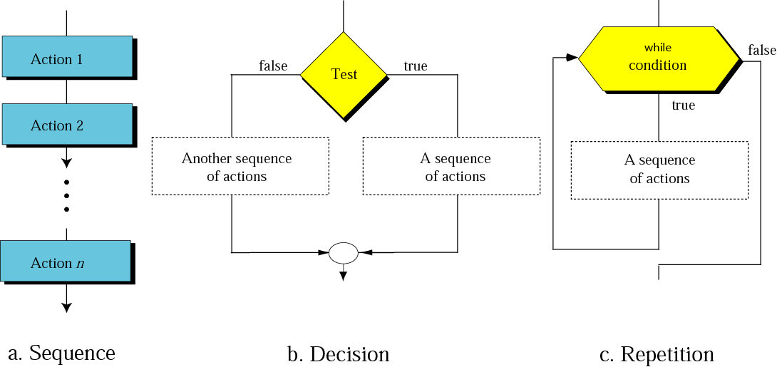
Flowchart For Three Constructs
Chapter – 2 : Algorithms and Flowcharts

Slide 29
Example of Flowchart
Example 1: Draw a Flowchart to find the average of two numbers
Example 2: Draw a Flowchart to find maximum number from 2 numbers
Example 3: Draw a Flowchart to find maximum number from 3 numbers
Chapter – 2 : Algorithms and Flowcharts

Slide 30
To find the average of two numbers
Example- Sequence
START
Input no1, no2
avg ← (no1 + no2) / 2
Print “Average = “,avg
STOP
Chapter – 2 : Algorithms and Flowcharts

Slide 31
To find maximum number from 2 numbers
Example- Decision
START
Input
VALUE1,VALUE2
TRUE
VALUE1>VALUE2
FALSE
MAX ← VALUE1
MAX ← VALUE2
Print
“The largest value is”, MAX
STOP
Chapter – 2 : Algorithms and Flowcharts

Slide 32
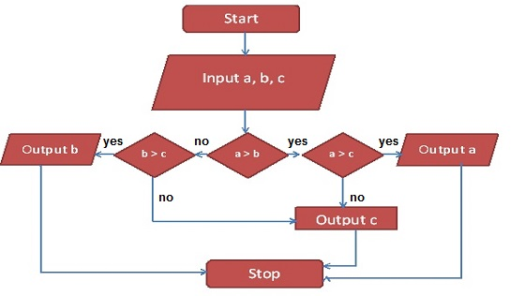
To find maximum number from 3 numbers
Example- Decision
Chapter – 2 : Algorithms and Flowcharts

Slide 33
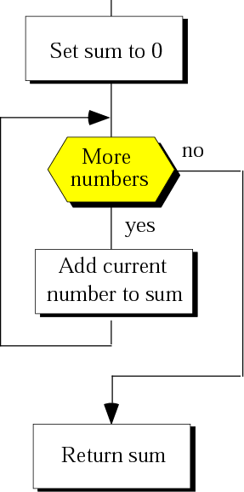
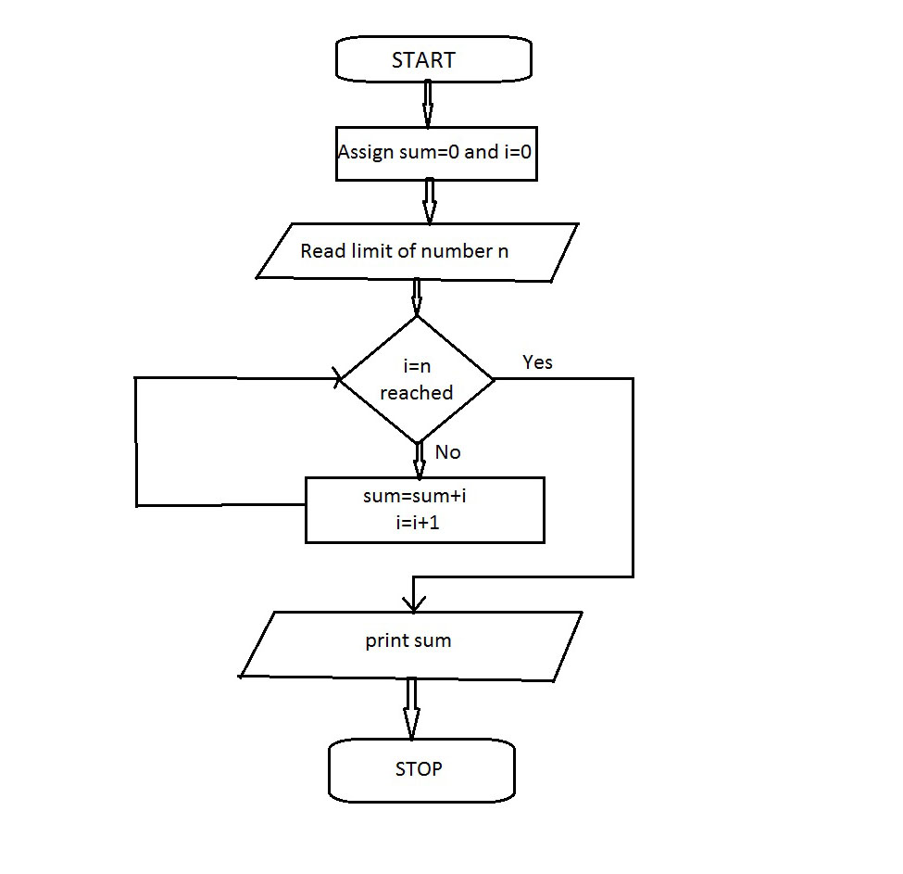
To find Sum of N Numbers
Example- Repetition
Chapter – 2 : Algorithms and Flowcharts

Slide 34
Advantages of Flowchart
Communication: Flowcharts are better way of communicating the logic of a system to all concerned or involved.
Effective analysis: With the help of flowchart, problem can be analyzed in more effective way therefore reducing cost and wastage of time.
Proper documentation: Program flowcharts serve as a good program documentation, which is needed for various purposes, making things more efficient.
Chapter – 2 : Algorithms and Flowcharts

Slide 35
Advantages of Flowchart
Efficient Coding: The flowcharts act as a guide or blueprint during the systems analysis and program development phase.
Proper Debugging: The flowchart helps in debugging process.
Efficient Program Maintenance: The maintenance of operating program becomes easy with the help of flowchart. It helps the programmer to put efforts more efficiently on that part
Chapter – 2 : Algorithms and Flowcharts

Slide 36
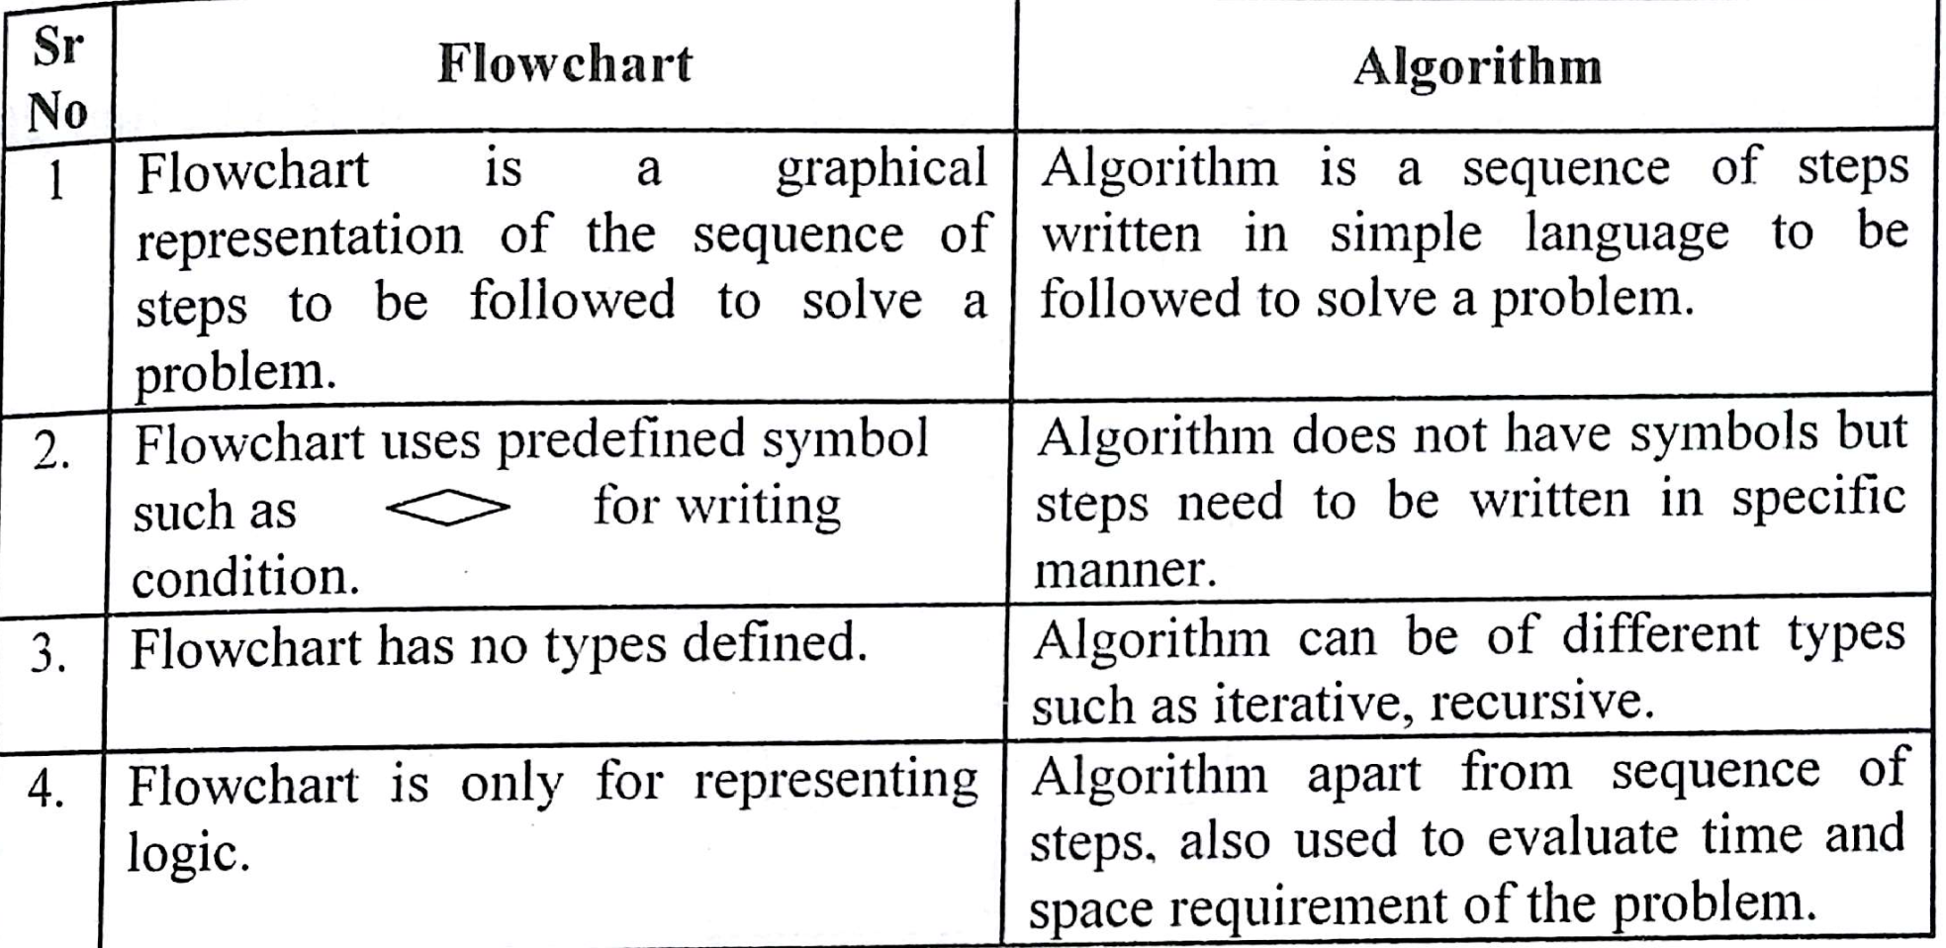
Difference Between Algorithm and Flowchart
Chapter – 2 : Algorithms and Flowcharts

Slide 37
Previous Year Questions
Write an algorithm and draw the flowchart to convert the decimal value to binary
Write an algorithm and draw the flowchart to create below pattern
    1
    0 1
    1 0 1
    0 1 0 1
    1 0 1 0 1
Differentiate Algorithm and Flowchart
Draw the flowchart to exchange two numbers without using third variable.
Chapter – 2 : Algorithms and Flowcharts

Slide 38
Previous Year Questions
What do you mean by algorithm? Draw a flowchart for finding the reverse number of any given number.
Draw a flowchart to calculate the parking charges of a vehicle. Input type of a vehicle (bus, truck, car) and number of hours. Calculate the charges as given below: truck / bus - 20 rs per hour car – 10 rs per hour scooter/bike = 5 rs per hour.
Write an algorithm to swap two numbers without using third variable.
Draw the flowchart to find the factorial of a number.
Write an Algorithm to find Fibonacci series upto n terms. 0 1 1 2 3 5 8 ….
Chapter – 2 : Algorithms and Flowcharts

Slide 39
Previous Year Questions
Write an algorithm and draw the flowchart to check whether given number is prime or not?
Draw the flowchart to add 1 to N numbers
Draw the flowchart to find maximum number from 3 numbers
Write an algorithm and draw a flowchart to read the marks of a student and classify them into different grades. If the marks secured are greater than or equal to 90, the student is awarded Grade A; if they are greater than or equal to 80 but less than 90 , Grade B is awarded ; if they are greater than or equal to 65 but less than 80, Grade C is awarded; otherwise Grade D is awarded.
Chapter – 2 : Algorithms and Flowcharts

Slide 40

Computer Science: A Structured Programming Approach Using C

